Slide 1
Law Firm Accruals Training
Template

Slide 2
How to Use This Template
Purpose: A framework for training your law firms on the importance of accruals, how to accurately and effectively calculate them, and how and when to submit them
Review the template and take note of slides that require customization based on your process with your outside law firms
Add / update slides with your company’s information and process
Share slides with your law firm(s) and discuss the purpose of the training deck (slide 5)

Slide 3
Template Topics
Reporting Legal Accruals “WIP” / Unbilled Estimates
Calculating Accruals for Non-Completion Matters
Calculating Accruals for Completion Matters

Slide 4
Reporting Legal Accruals
“WIP” / Unbilled Estimates
Law Firm Training Deck Template

Slide 5
Importance of Accrual Information
Securities and financial requirements mandate that companies keep and report accurate accounting records
Accruals are critical to those reporting obligations
Companies rely on you to provide accurate Accrual information
Accruals (WIP – Work in Process / Unbilled Estimates): costs / expenses, such as legal fees, for services that have been provided but not yet invoiced as of a cut-off date (accrual basis accounting)

Slide 6
When to Submit Accruals
[ Provide instructions on how communication will be sent to your law firms indicating that accrual period is open – SimpleLegal example below ]
Open
4 business days before end of month (8am PST)
Close
2 business days before end of month (12pm PST)
SimpleLegal will send you 3 email reminders:
3 days before the accrual window opens
The day the accrual window opens
The day the accrual window closes

Slide 7
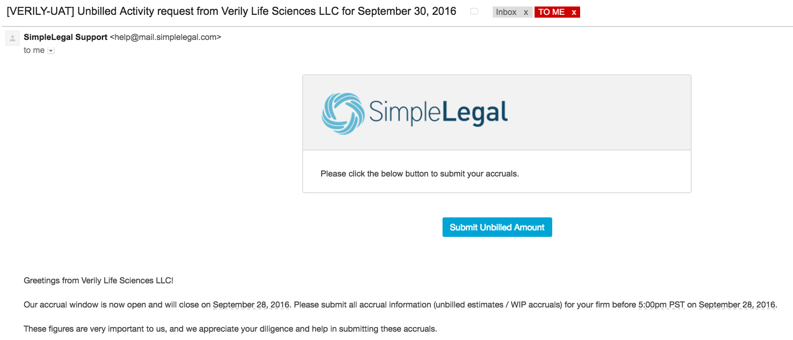
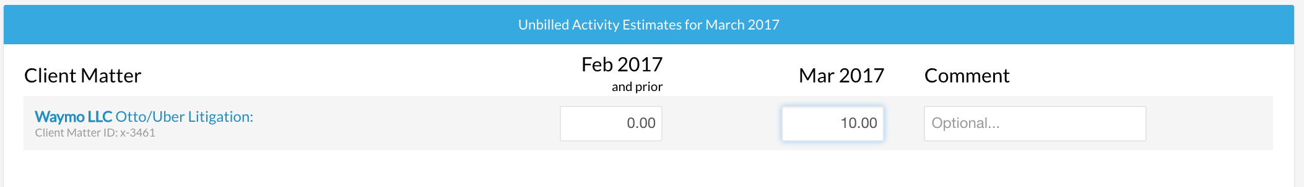
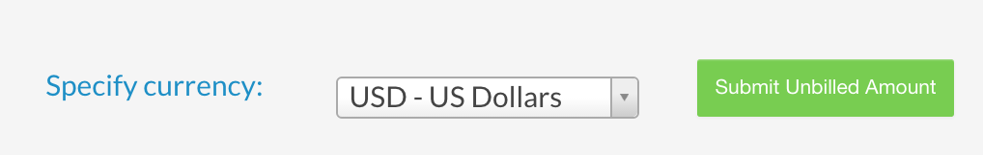
How to Submit Accruals
[ Provide instructions on how your law firm will enter Accrual information – SimpleLegal example below ]
Click email link to “Submit Unbilled Amount”
Step 1
1
2
Enter 2 numbers for each matter:
  Prior periods (e.g. Feb 2017 and prior) unbilled
  Current month (e.g. Mar 2017) unbilled
Step 2
3
Click “Submit Unbilled Amount” at bottom of page
Step 3

Slide 8
Calculating Accruals for
Non-Completion Matters
(Commercial, Corporate, Contract, Litigation, Employment)

Slide 9
Accruals for Non-Completion Matters
Prior Month Services Provided Not Yet Invoiced + Current Month Services Provided Not Yet Invoiced =
Month End Accrual
Prior Periods: For each matter, enter the cumulative amount of all unbilled fees / expenses your firm incurred in every month that PRECEDES the current month
  Exclude prior period unbilled fees/expenses that will be invoiced to [ insert company name ] before the accrual window closes
  Include prior period unbilled fees/expenses that will be invoiced to [ insert company name ] between accrual window closing and end of the current month
IMPORTANT NOTE: Remember to report the cumulative amount for all unbilled fees and expenses until you submit an invoice for the work.
Once you invoice work, you should reduce the total unbilled fees / expenses by the amount that has been invoiced.
Current Period: For each matter, enter the amount of unbilled fees / expenses your firm already incurred in the current month plus the amount of unbilled fees / expenses you expect to incur through remainder of the month
  Exclude current period unbilled fees / expenses that will be billed to [ insert company name ] before the accrual window closes
  Include current period unbilled fees / expenses that will be billed to [ insert company name ] between accrual window closing and end of the current month

Slide 10
Example (for law firms)
Situation
The March month end accrual window opens Wednesday March 29th and closes Friday March 31st
Firm has completed work on matter 123 beginning January 1st - present
Prior Month Accrual
Firm determines that from the period of January 1st - February 28th $100k of services have been provided against matter 123
Of the $100k of services, invoices for $85k were submitted by March 28th
Therefore, prior month unbilled estimates accrual is $15k ($100k services - $85k invoiced = $15k unbilled)
Current Month Accrual
Firm estimates that from March 1st - March 28th $25k of services have been provided against matter 123
Of the $25k of services, invoices for $10k were submitted by March 28th for approval and payment. The remaining $15k will be invoiced at a later date.
Additionally, the firm estimates that an additional $5k of services will be performed during March 29th - March 31st
Therefore, current month unbilled estimates accrual is $20k ($15k unbilled from March 1st - March 28th + $5k estimated March 29th - March 31st)
Solution
Firm enters the following Accruals in SimpleLegal during Accrual Window for Matter 123:
Prior Periods: $15k
Current Period: $20k
January 1
February 1
March 1
April 1
May 1
Prior Accrual: $15,000
Current: $20,000

Slide 11
Calculating Accruals for Completion Matters
(Patent / Trademark Application Preparation and Prosecution)

Slide 12
Accruals for Completion Matters
Fees and expenses for completion billing work are to be accrued the month the work is completed.
Accruing flat-fee tasks (identified on Patent / Trademark Fee Schedule)
Flat-fee amount plus any related expenses the month the task is completed
Example: Application drafting begins January and is filed March.
  In January, you accrue $0; In February, you accrue $0; In March, you accrue $X (application filing flat fee) + $Y (expenses, e.g., PTO filing fees)
Accruing non flat-fee tasks (hourly billable work)
Billable hour amount plus any related expenses the month the task is completed
Example: 3P project begins January and is completed March
  You spent 10 billable hours in January, 3 billable hours in February, and 5 billable hours in March
  In January, you accrue $0; In February, you accrue $0; In March, you accrue $X (18 billable hours x hourly rate) + $Y (expenses, e.g., outsourcing/vendor fees)
Accruing other expenses/disbursements (e.g., pass through foreign agent invoices)
Amount of invoices as incurred (passed on to your firm)

Slide 13
Accruals for Completion Matters
[ Provide instructions for how law firms will file accruals for completion matters - example below ]
DO NOT report accruals at the individual matter level
Combine all completion billing accruals for [ insert company name matter ] and report against the following SimpleLegal accrual matter:
[ insert identifier / company name ] Patent Accruals (matter #200000017)

Slide 14
Example (for law firms)
August 1
September 1
October 1
November 1
December 1
Matter Y: Application started
Matter Z: OAR started and completed / filed
Matter Y: Application completed/filed
Situation
In August, Firm begins performing Matter Y, a new patent application, but does not complete it in August. Because patent applications are a completion billing task, and the work is not completed, the current period accrual is $0.
In September, Firm begins performing Matter Z, an office action response, and completes it in September. The firm reports a current period accrual of $3,000 (the flat fee for the OAR task). No invoices will be submitted until November.
In October, Firm finishes Matter Y. The firm reports a prior period accrual of $3,000 (for the uninvoiced OAR task), and a current period accrual of $13,000 ($10,000 flat fee for application filing task + $3,000 PTO filing expenses).
Solution
Firm enters the following Accruals:
August Prior Periods: $0 September Prior Periods: $0 October Prior Periods: $3,000
August Current Period: $0 September Current Period: $3,000 October Current Period: $13,000

Slide 15
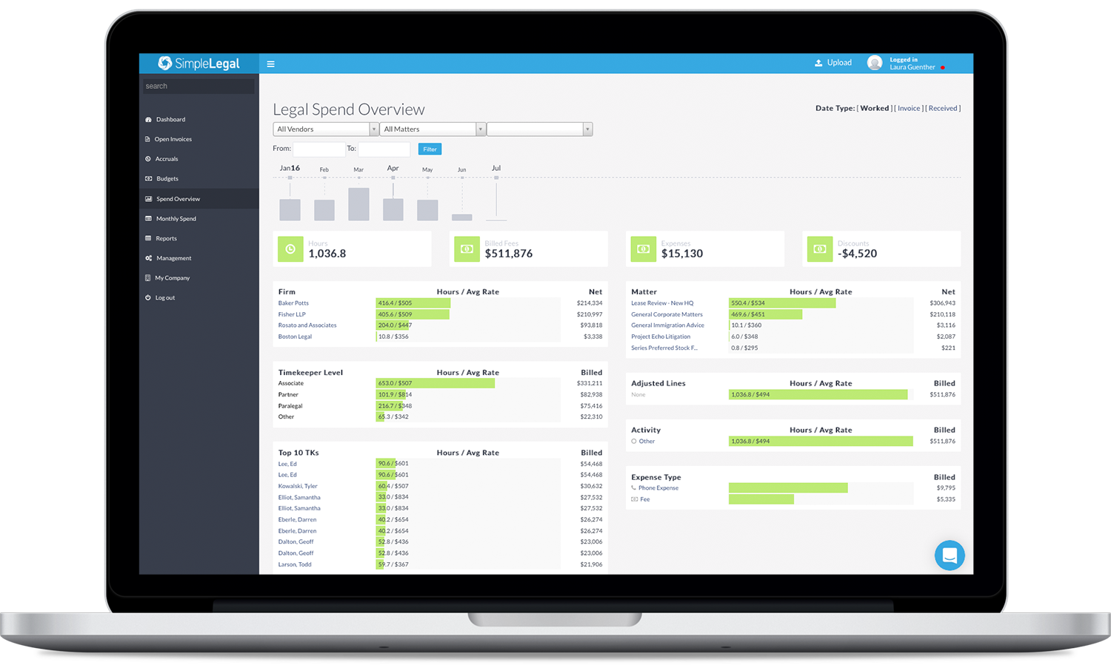

A Better Way to Manage Your Legal Department
Intuitive Legal Spend & Matter Management Software
Budgeting, Reporting & Analytics For Better Insight
Integrations with AP, IP Management, SSO, & More
www.simplelegal.com | sales@simplelegal.com | (650) 376-0604

